Slide 2


ONE CALL GETS IT ALL
Jim Rowan
Managing Director
Dunns Food and Drinks

Slide 3
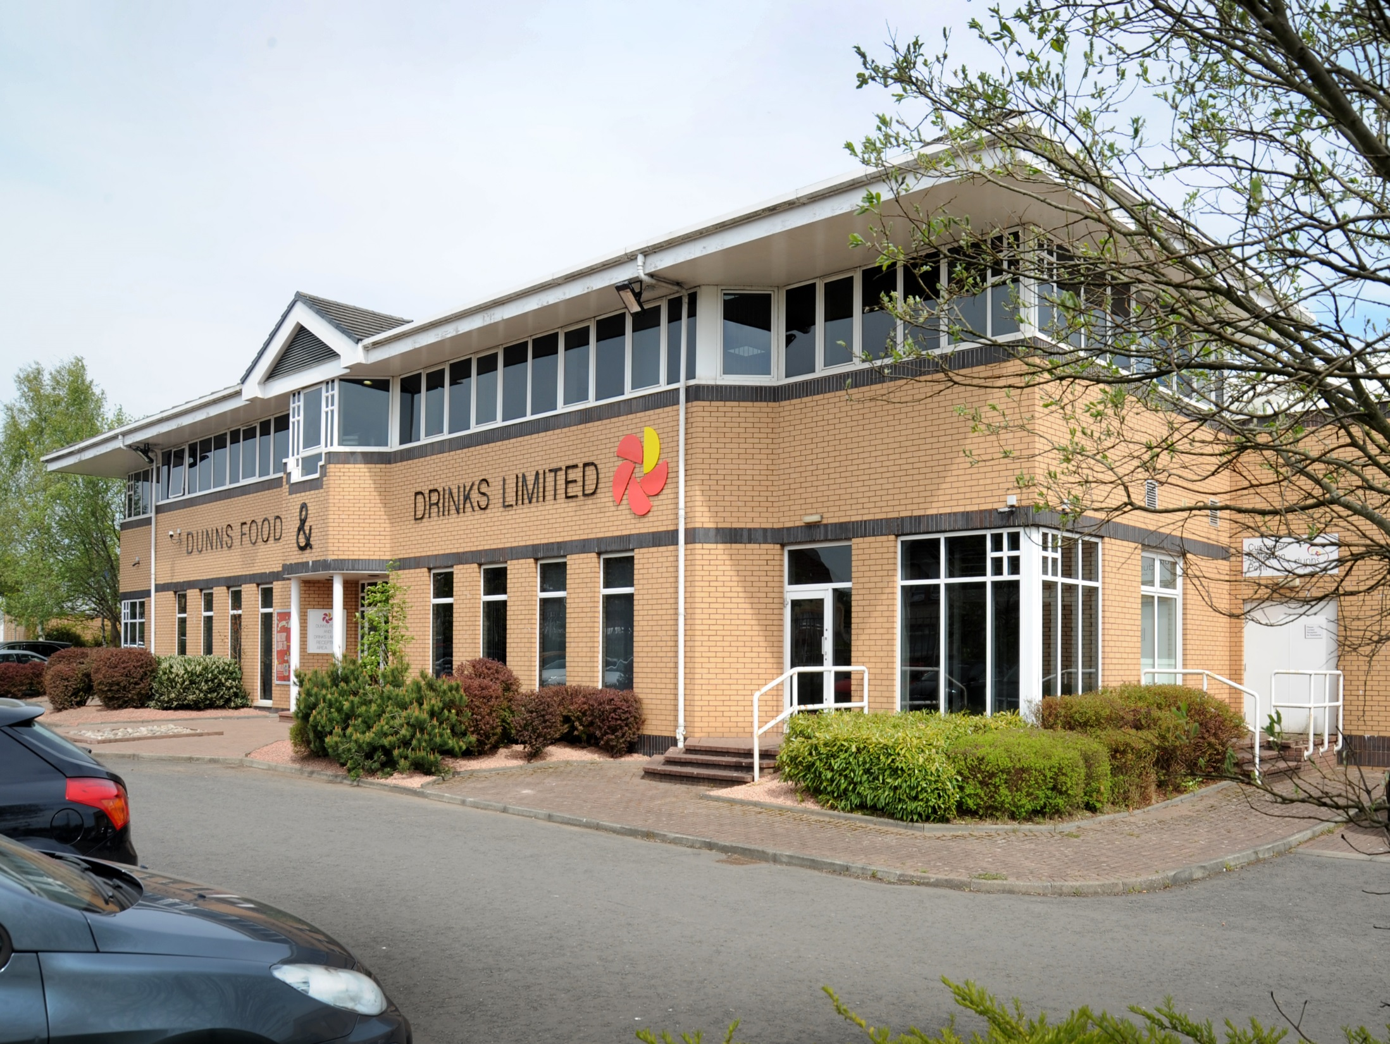
DUNNS FOOD AND DRINKS
One of Scotland’s most historic family businesses, the heritage of the company was in Soft Drinks, Joseph Dunn having founded his lemonade factory in 1875.
Today, we are a multi award-winning delivered wholesaler. We are growing rapidly throughout the country with a remarkable portfolio of products from around the world covering chilled, ambient and frozen, as well as drinks of all descriptions.
In 2017, we’ve been recognised as having Scotland’s Best Delivered Operation in Foodservice at the SWA Achievers Awards – and have been voted Scotland’s Food Wholesaler of the Year for the THIRD YEAR running at DRAM’s Scottish Pub and Bar Awards!

Slide 4



OUR JOURNEY
If we look back 30 years, what was once science fiction is now becoming fact.
THE EVOLUTION OF MAN FOODSERVICE
CHANGING FACES

Slide 5




THE MARKET

Slide 6






TECHNOLOGY

Slide 7

WHAT IS FOODSERVICE?
It defines those businesses, institutions and companies responsible for any meal prepared outside the home.
This includes restaurants, hotels, leisure, schools, hospitals, catering operations and now garage forecourts, coffee shops and convenience stores.

Slide 8







WHAT IS FOODSERVICE?
UK
£10.4 BILLION
Approx 35% of UK wholesale market
25k Direct employees
£600m in salaries
£170m in tax
360k jobs supported indirectly
SCOTLAND
£1 BILLION
Approx 2.8%
3k Direct Employees
£60m in salaries
£14m in tax
30k jobs supported indirectly
*Figures based on IGD sector analysis for 2016, and FWD/Capital Economics research

Slide 9






WHAT IS FOODSERVICE?
CUSTOMERS – All businesses servicing the out of home market.
2016: Solid growth across both RTM (delivered foodservice and primarily C&C)
Expertise, innovation and consumer demand for eating out benefiting delivered wholesalers.
ROUTES TO MARKET*
Delivered Foodservice
Primarily C&C
Total
2015
£6,946m
£2,979m
£9,925m
2016
£7,094m
£3,024m
£10,118m
% Change
2.1
1.5
1.9
2017
£7,271m*
£3,027m*
£10,298m
*Source IGD Retail Analysis
Delivered anticipated to grow at 2.5% to 2021 and Primarily Cash and Carry 0.1%

Slide 10




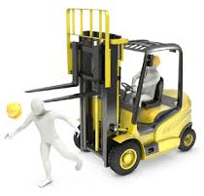
WHAT ABOUT ALL THOSE JOBS UNACCOUNTED FOR?
TAX OFFICIALS
LAWYERS
MECHANICS
I.T
HEALTH & SAFETY
TRAINING

Slide 11
ESTIMATED SHARES
Brakes, Booker and Bidfood – 49%
Independents – 31%
Buying Groups – 14%
JJ/Costco/Reynolds – 6%
*Source IGD Retail Analysis (IGD Research & Horizons)

Slide 12
CHANNEL GROWTH AREAS
Major growth areas:
- BWS
- Chilled/Fresh
Major growth areas:
- Frozen
- Chill/fresh
- Softs
*Source IGD Retail Analysis (IGD Research & Horizons)

Slide 13
PATHWAYS TO SUCCESS
TRAINING REQUIREMENTS & OPPORTUNITIES
SALES
LOGISTICS
OPERATIONS
FINANCE/ADMIN
Negotiation Skills
Presentation Skills
Listening & Questioning
Allergen Training
Waste Management
Nutrition
Selling Stories
Telephone Selling
Commercial Awareness
Customer Insight
IT
Driver Training
Warehouse Management
Fork Lift Training
Healthy & Safety
IT
Procurement
Negotiation Skills
Computer Skills
Marketing
Purchase Ledger
IT
Office Management
Accountancy
Sales Inventory
Purchase Ledger
IT
KEY ACTIVITIES

Slide 14

RISING STARS OF WHOLESALE

Slide 15
PATHWAYS FOR PROGRESS
RISING STARS OF WHOLESALE
MODERN APPRENTICESHIPS
ILM (Institute of Leadership & Management)
CHARTERED BODIES
16+
16-24 (FULLY FUNDED)
25+: (PART FUNDED: FOOD
& DRINK SPECIAL STATUS
SUPPORTED BY SWA
POSSIBLE BURSARY SYSTEM
ENTRY
(HNC)
GRADUATE
(DEGREE)
DEVELOPING LEADERSHIP & MANAGEMENT SKILLS
MENTOR PROGRAM
DEVELOPING THE SENIOR TEAM
WORKING WITH SDS TO CREATE A NATIONAL FRAMEWORK APPLICABLE TO WHOLESALE WITH NATIONALLY APPROVED PROVIDERS.
WORKING WITH ILM APPROVED PROVIDER
WORKING WITH
CIM APPROVED PROVIDERS / FACILITATORS
SALES.
LOGISTICS
OPERATIONS
FINANCE/ADMIN

Slide 16
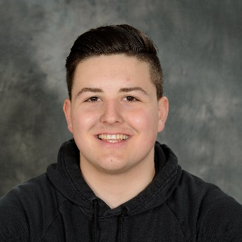
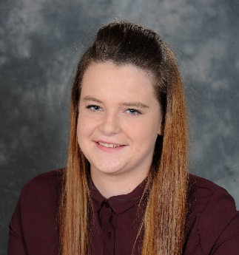
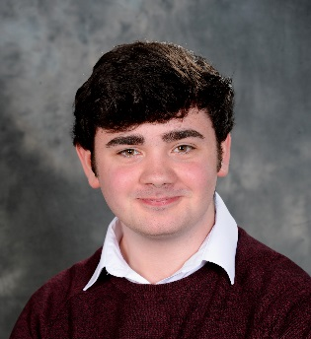
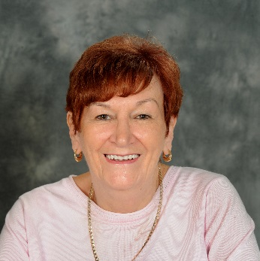
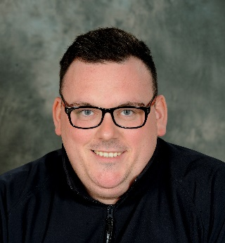
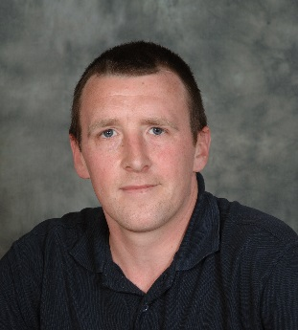
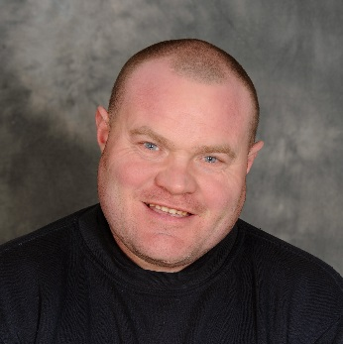

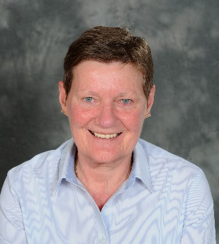
PATHWAYS FOR PROGRESS
SOME OF OUR APPRENTICES
At Dunns, we have made a strategic decision to invest in “growing our own”.
At trading year end 2015, 13% of our workforce was under 23.
At trading year end 2016, 23% of our workforce was under 23.
We’ve since added more graduates, and have several more young members of our team undergoing apprenticeships.
Aidan: Warehouse
Justine: Finance
Grant: Finance
24% OF OUR STAFF HAVE OVER 10 YEARS OF SERVICE
OVER 10 YEARS
OVER 20 YEARS
+
MANY
MORE!
Irene: Telesales
Paddy: Despatch
David: Despatch
Alan: Warehouse
Ronnie: Despatch
Linda: Finance

Slide 17





THE CHALLENGE FOR OUR INDUSTRY
ATTRACT
TRAIN
RETAIN

Slide 18


LET’S ACT TOGETHER
THANK YOU.

