Slide 2

Reasons to Believe
Ross Brown
Channel Controller - Foodservice
Premier Foods

Slide 3
Reasons To Believe
A bit about me
The SWA Foodservice Group
  Who are we
  What do we do
The Opportunity & Benefits
The Challenge – Two Fold

Slide 4


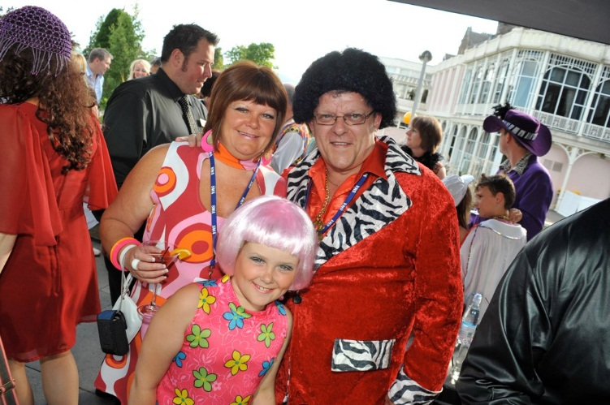

Who Am I……….. Ross Brown
Married the lovely Christine 2014
Our Gorgeous Daughter Gemma is now 17
Started life with the Co-op then joined Premier Foods 39yrs ago
Cadbury Typhoo Feb 1979
Invited to join the C&C Sales Team 1986
Moved into The Foodservice Channel 1990
Offered 1st Nam role in FS 1999

Slide 5
The SWA Foodservice Group…….. Who are we
5 Wholesalers
2 Suppliers
1 Public affairs
2 SWA

Slide 6
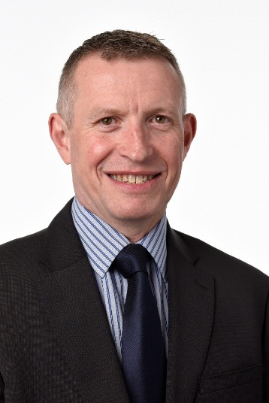

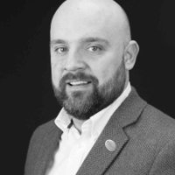

The SWA Foodservice Group…….. Who are we
Jon Mack
General Manager
Member of SWA Council
Chris Boyle
Channel Head - Public Sector Scotland

Slide 7
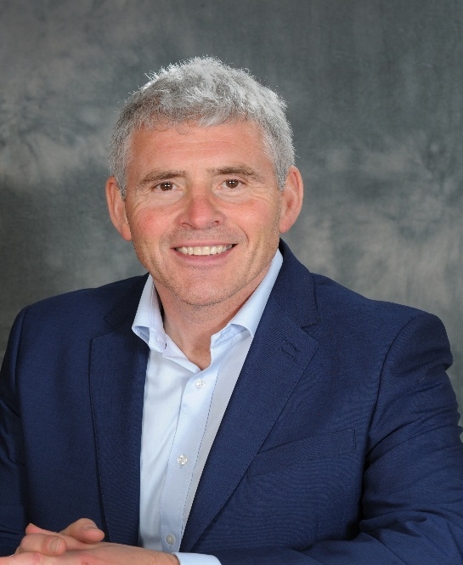
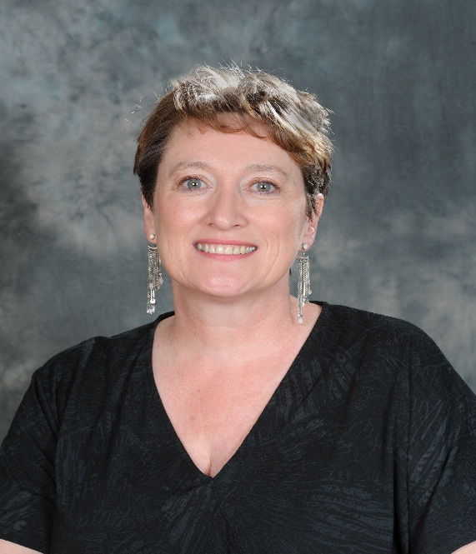
The SWA Foodservice Group…….. Who are we
Jim Rowan
Managing Director
Board Director Country Range Group
Julie Dunn
Operations Director
President SWA

Slide 8
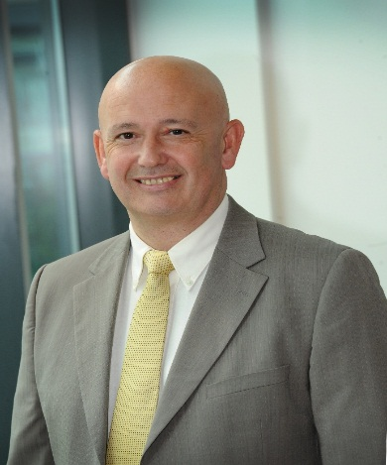

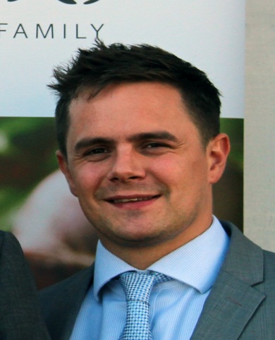

The SWA Foodservice Group…….. Who are we
Jim Cummisky
CEO - Failte Group
Member of SWA Council &
Co-Chair SWA Foodservice Group
Board Member – Today’s Group
Angus Patterson
Operations Manager

Slide 9
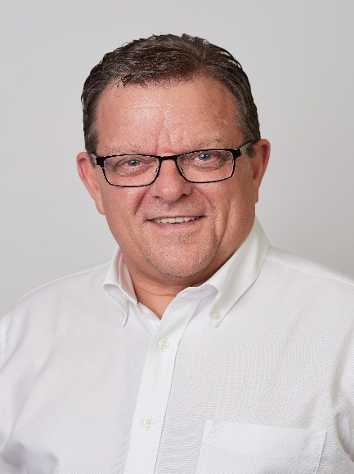
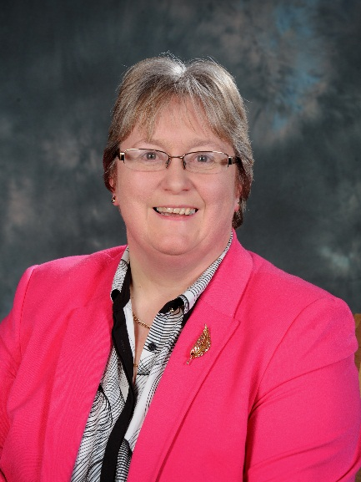
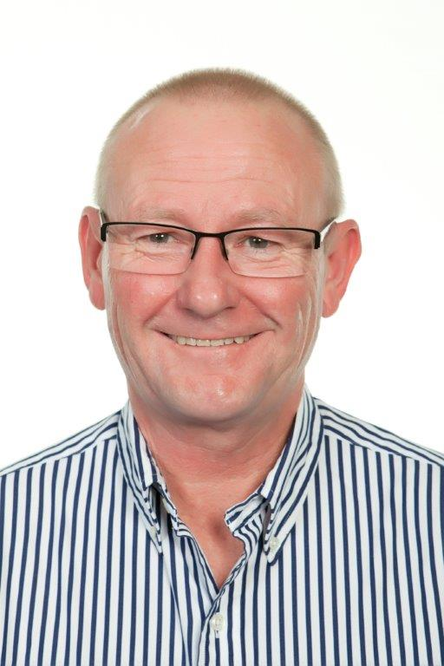



The SWA Foodservice Group…….. Who are we
Ross Brown
Channel Controller - Foodservice
Co-Chair SWA Foodservice Group
Margaret Smith
Director
John Taylor
Regional Sales Manager

Slide 10
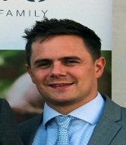




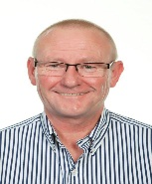

And What do we do? Our Vision
Liaison
Lobbying
Legislation
Ensure that foodservice members can access best in class industry support, via SWA, to deal with legislative challenges.
Training
Events
A trusted, foodservice-specific body, promoting best practice among members, using industry experts to overcome challenges and drive growth
Provide members with a coordinated voice when talking to stakeholders and use that voice to identify solutions for Foodservice sector issues.
Provide first class training and affinity services for foodservice members, via SWA, as a means of building capability and strength in the foodservice sector.
Facilitate the opportunity for members to network with their peers & suppliers whilst they are learning, sharing & understanding issues which may affect their business

Slide 11



And the opportunity?
450
£Million Turnover
110
350
130
Sales People
Delivery Vehicles
Telesales Operators

Slide 12
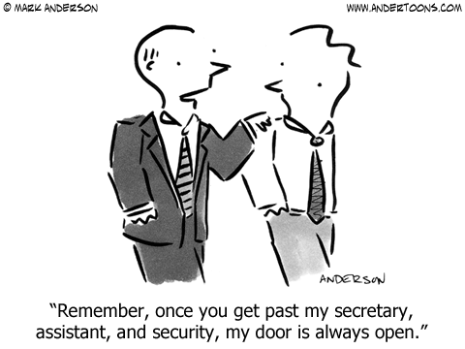
What’s in it for you - Suppliers

Slide 13

What’s in it for you – OPEN DOORS
Events, Networking & Sponsorship
  Achievers – Networking & Brand Visibility
  Annual Conference – Networking, Brand Visibility & Family Fun
  Training & Mentoring – Sponsorship and/or Sharing knowledge and skills,
  Access to Sales Teams – Sharing Product Knowledge
Forums for Partnerships
  Information exchange – Sales Data & Insight
  Networking- Key Industry Stakeholders & Decision makers
  Sharing Best Practise - Collaboration
Foodservice and C&C Groups
  Be Part of a group that will shape the Future Channel Initiatives in Scotland
  Share Views & Expertise, with the Senior teams from Scotland’s Wholesalers
  Make a difference, by adding value into the Channel through Experience, Skills & Knowledge
  Sharing Best Practise to create the next big Initiatives
  Lobbying & Legislation

Slide 14
My challenge – Supplier
If you are not a member of the Association………………….. Come and join us,
Memberships opportunities from Kate, Jo or any of the Foodservice Group members
If you are a member of the Association………………….
Make the doors open to get your ROI
Be part of the Foodservice and C&C opportunity in helping shape the Scottish Wholesale future

Slide 15
My challenge – Wholesalers
OPEN YOUR DOORS
Work collaboratively with the suppliers who support the Association
Use their knowledge and expertise to your and your customers advantage

Slide 16
Thank You
FS Group members are around to answer
any questions & share our Group Values

