Slide 2
A JOB FOR LIFE, NOT JUST FOR XMAS!
David Cochrane
Chief Executive
HIT Scotland

Slide 3
The Hospitality/Tourism sector – 25,000 businesses
Direct Employees – 245,000
The Challenges in Scotland
Image
Retention
Chefs!
Also – Business rates, apprenticeship levy, living wage – a number of Global issues!
Solutions!
The
Industry

Slide 4
Assisting people
to be the best
they can be within Scottish Hospitality!
Year of Young People

Slide 5
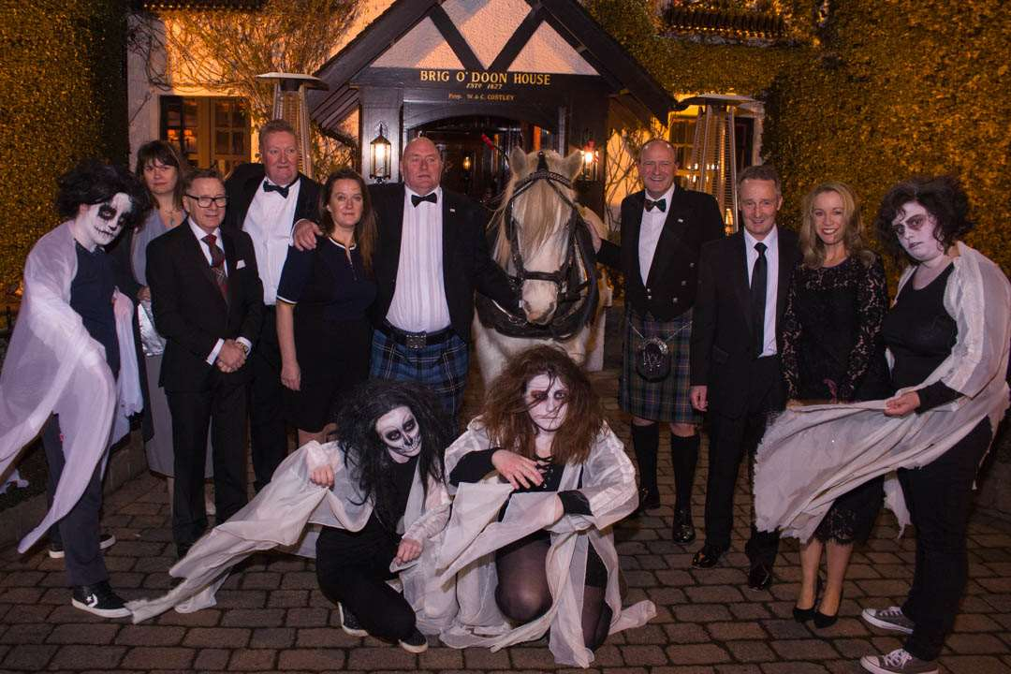
EVENTS
Giving customers
what they want!

Slide 6
1 event in ’94, now 27 per year
Industry led
Voluntary committees
Fundraising – tickets/raffles/auctions
Market driven - geographical
Event
management

Slide 7
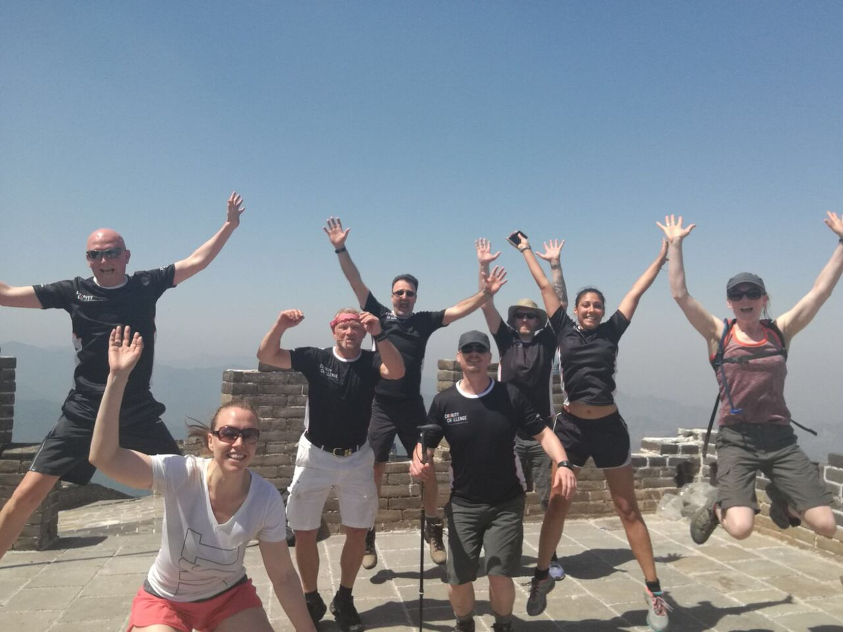
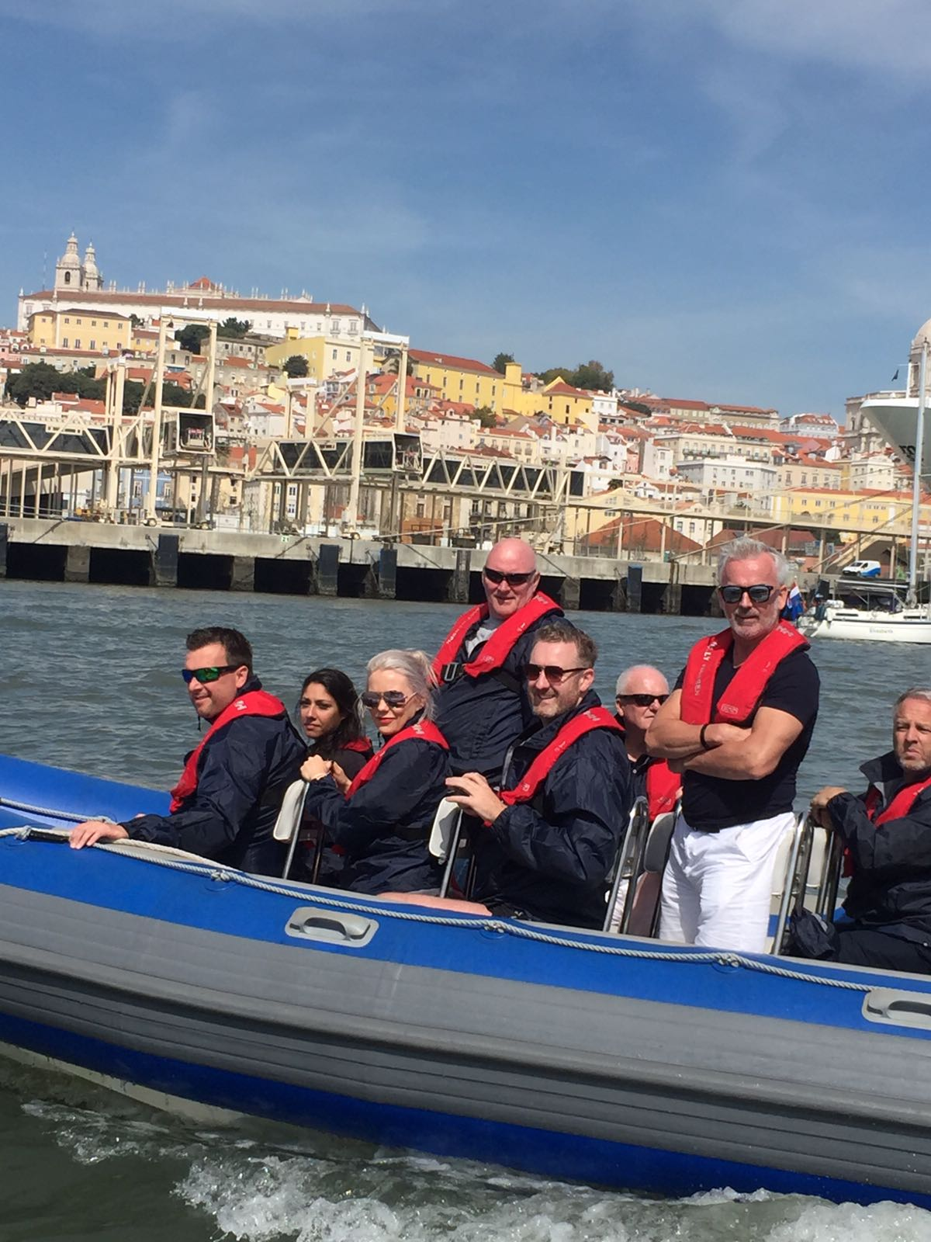
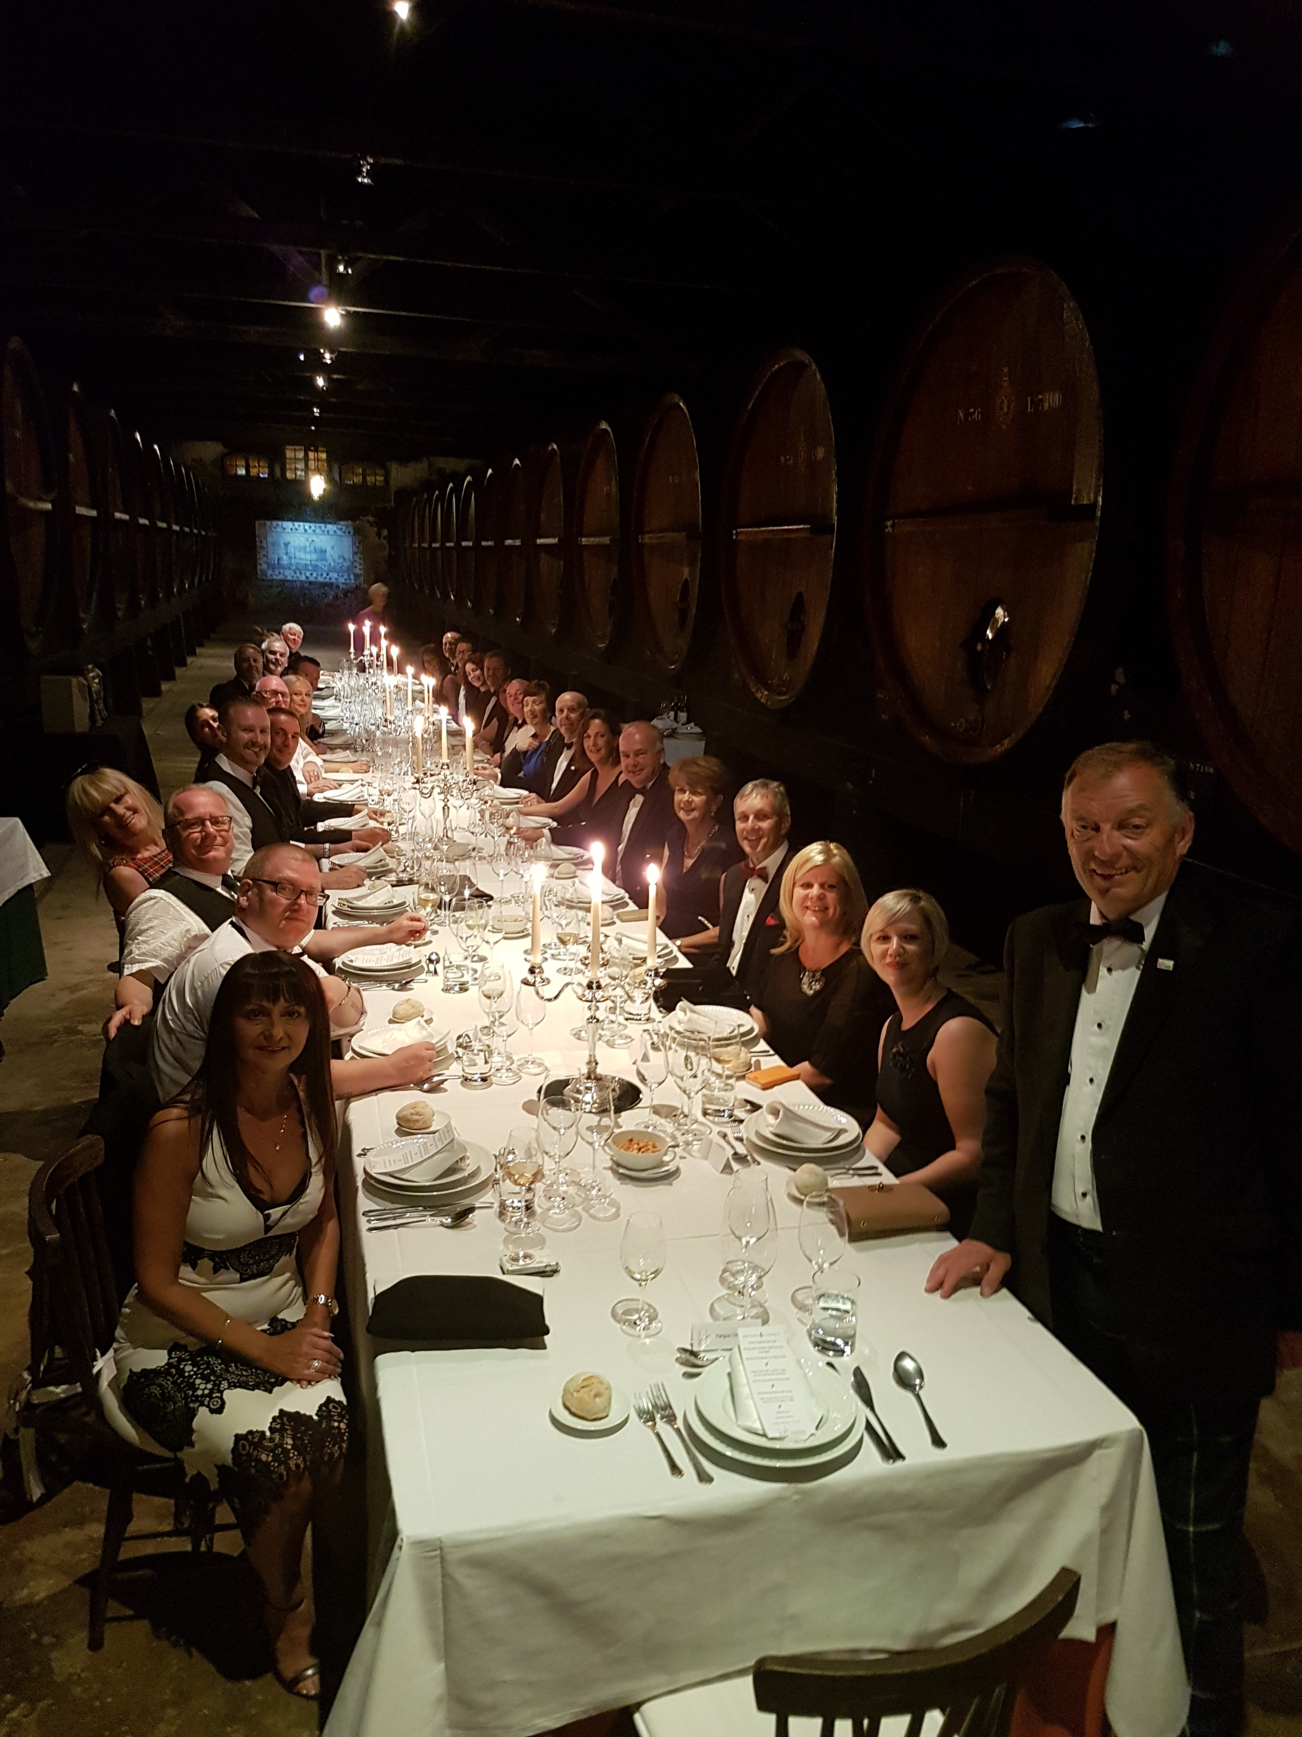
Challenges, networks, opportunities and collaborations

Slide 8
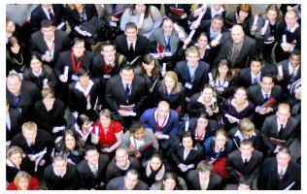
Scholarships

Slide 9
Over 2000 Scholarships awarded
Over 12,000 Bursaries provided
Support for craft skills groups
Bespoke Scholarships at all levels
Emerging Talent – any age!
Local, national and international
When did you last update your skills and knowledge!!?
Scholarships and bursaries

Slide 10
www.hitscotland.co.uk
Get in contact!
@HITScotland
david.cochrance@hitscotland.co.uk

