Slide 2


Keeping it Simple
Ants Rixon
Director of Regional Trade
Bibendum Wine Ltd (in partnership with Bidfood)

Slide 3






Ants Rixon
Director of Regional On Trade - Bibendum
ANTS RIXON - BIOGRAPHY

Slide 4

Bibendum Wine
It all began in a disused car showroom in 1982 with a group of friends selling wine to private customers.
35 years on we’re still based in Primrose Hill; selling wine and spirits to a wide variety of customers...from sporting venues to Michelin starred restaurants.
What started as a ‘stack it high, sell it higher’ fine wine warehouse in 1982 is now part of the largest drinks distributor in the UK, Conviviality Plc.

Slide 5

Award Winning Wines
MERCHANT OF THE YEAR Sommelier Wine Awards 2017
INNOVATOR OF THE YEAR International Wine Challenge 2016
NEW WORLD MERCHANT OF THE YEAR Sommelier Wine Awards 2016
SPECIAL COMMENDATION The Drinks Business Awards 2016
BEST LAUNCH OF THE YEAR The Drinks Business Awards 2015
MERCHANT OF THE YEAR Sommelier Wine Awards 2015

Slide 6
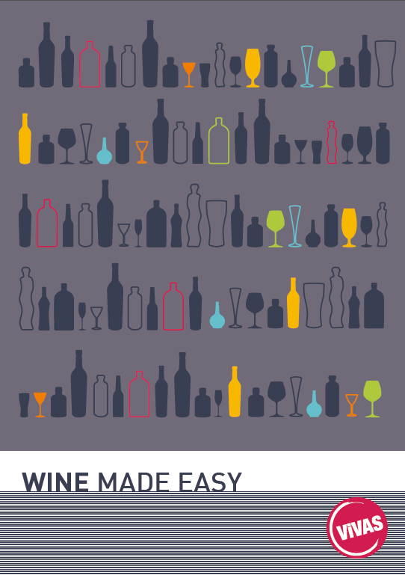
ViVAS - Wine Made Easy
ViVAS was created in 2008 as a joint venture between Bibendum and Bidfood (then 3663).
The partnership blends Bidfood's passion for food and local delivery network with the best quality wines from Bibendum, one of the UK's leading wine specialists.
Now in our 10th year, ViVAS is a £30m pa business supplying Wine, Beers and Spirits to a wide variety of customer types across the Free and National On-Trade

Slide 7
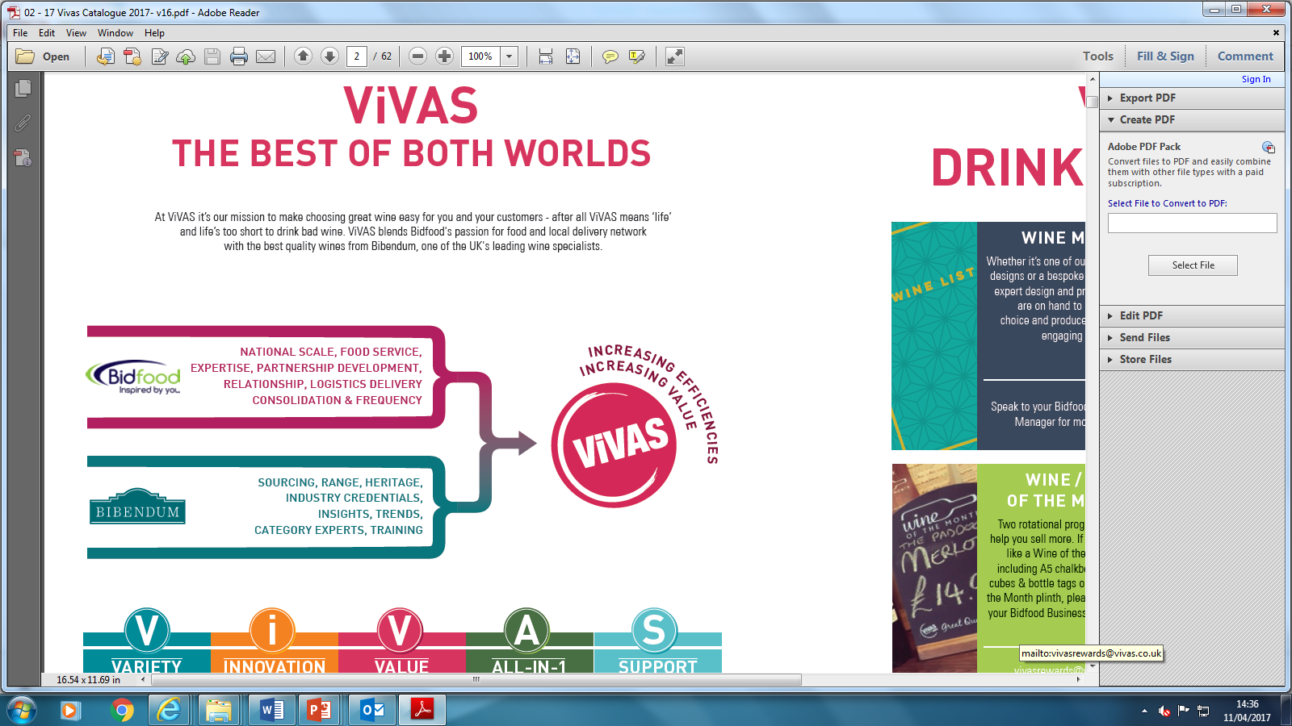
Flexibility, Efficiency & Logistical Advantage
The ViVAS range is delivered via Bidfood’s dedicated fleet alongside customers’ food orders
Because existing food supply routes are in place, the minimum order for ViVAS is just one case, with next day delivery up to 6 days a week.
One Order, One Delivery, One Invoice – cutting down admin hours, increasing efficiency and delivering flexibility.
A unique offering unparalleled in the On-Trade

Slide 8
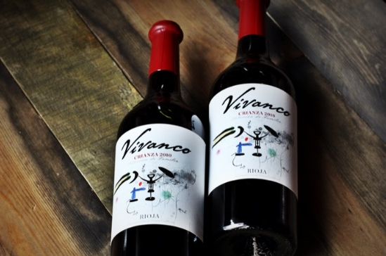
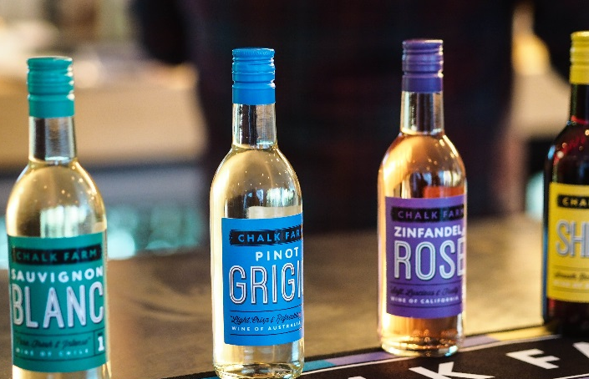
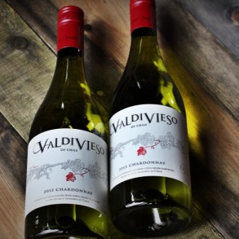
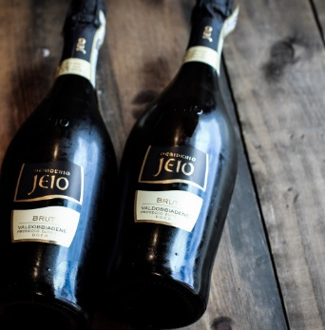
Our Range - Wine
Our portfolio features over 230 still and sparkling wines from 16 countries worldwide; from Old World classics to New World wonders.
This concise range is designed to reach all the most commercially important touchpoints on any wine list – simplicity and relevance are key to the offering.
x12 ViVAS exclusive brands to maintain unique proposition.
Access to Bibendum’s Fine Wine range when required.
Bibendum ship from country of origin directly into the Bidfood network, reducing handling costs and making our pricing very competitive.

Slide 9
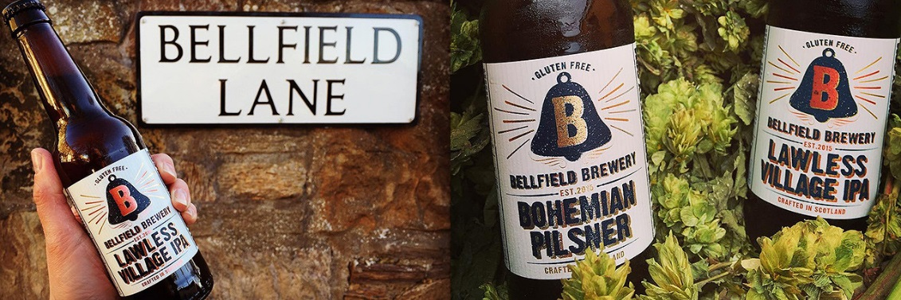



Beer, Cider, Spirits, RTDs & Softs
We’re passionate about wine but we also have everything in-between to give our customers a one-stop-shop including:
  Ales
  Craft Lagers
  Ciders
  Full range of Spirits
  Full range of Softs
  Miniatures, PETs, Cans, Bottles, 20litre Kegs

Slide 10


Think Local…
Consumer demand in local, artisan products continues to grow.
In response we’ve listed many new craft ales, ciders and whiskies which reflecting Scotland’s regional diversity.

Slide 11
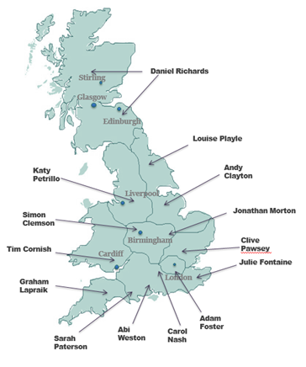
Making Wine Easy - Our People
We passionately believe in making wine easy for our customers.
Our dedicated category management team work in partnership with customers to maximise profit in their businesses utilising:
  Bespoke staff training
  Advice on wine list design
  Consumer tastings and events
  Merchandising tips
  Staff incentives
  Promotional calendars

Slide 12
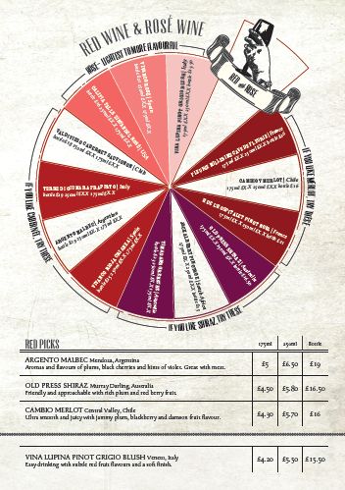
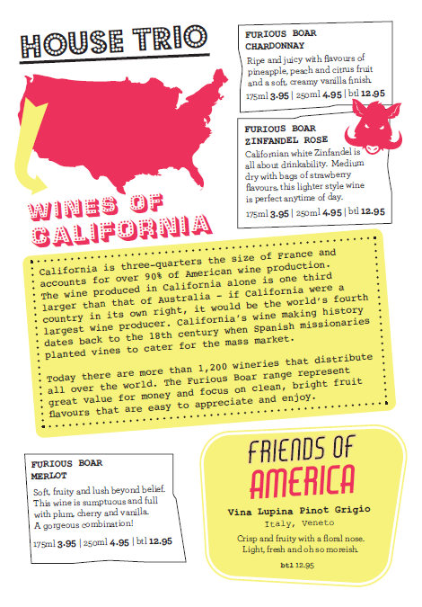
Wine List Design – The Silent Salesman
Our customers sell better quality and more profitable wine by implementing compelling, bespoke wine lists utilising proven psychology and innovative creatives.
We have a dedicated graphic designer in Bibendum’s marketing team giving us flexibility to turn around projects quickly.
Whether it be a simple list from our templated bank or a bespoke piece of work – ViVAS design delivers solutions which delight customers and make selling wine easier and more profitable.

Slide 13


Wine Training
Our philosophy is simple - we want to make wine and spirits fun, easy to understand and accessible to everyone.
At all levels our training is engaging, interactive and relevant.
We tap into Bibendum’s award winning training team ta variety of customer training including:
  WSET Levels 1,2,3
  On-Site bespoke training days
  Train the Trainer
  Wine Foundations
  Sales Toolkit

Slide 14
THE ViVAS ADVANTAGE
Unique joint venture bringing together the market leaders in Wine and Foodservice
The best of both worlds – award winning wine range delivered alongside food requirements
Efficiency of One Order – One Delivery – One Invoice driving customer cost savings
Added value – award winning training, wine list design and category management
Wine made easy.

Slide 15

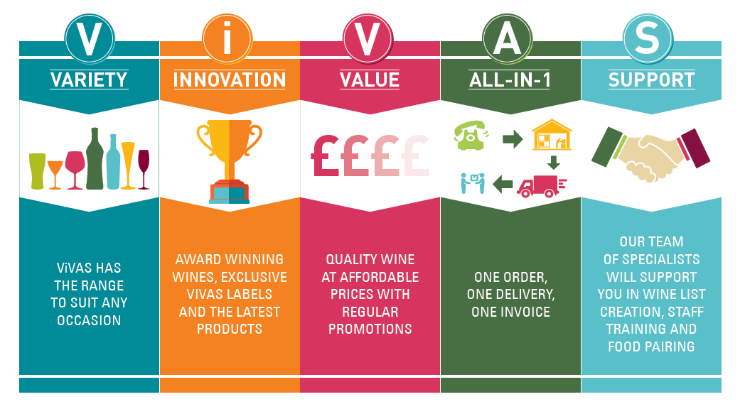
THANK YOU

